Slide 1

Christmas Treasure
Game

Slide 2
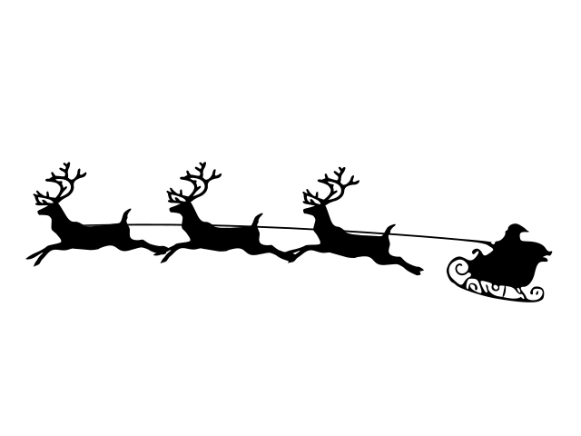



Team member
Lê Phan Hồng Huế - ITDSIU23032
Nguyễn Thị Diễm Quỳnh - ITDSIU23021
Lê Thị Ngọc Tuyền - ITDSIU23028
Trần Thị Kiều My - ITCSIU23026

Slide 3

TABLE OF CONTENT
01
INTRODUCTION
02
RULE AND GAME PLAY
03
THE LOGIC DETAILS AND GAME TECHNIQUE

Slide 4


INTRODUCTION
Project Name: "Christmas Treasure" - A 2D Platformer Game
Objective: Demonstrate OOP principles and design patterns
Programming Language: Java
OOP Concepts Used: Inheritance, Abstraction, Encapsulation, Polymorphism

Slide 5

RULE AND GAME PLAY
Controls:
Movement: W (up), A (left), S (down), D (right)
Attack/Interaction: ENTER (attack, select items, interact with NPCs)
Special Actions:
P: Pause the game
T: View map position
C: Open inventory/check status
Space: Shoot snowballs
ESC: Adjust volume or exit the game

Slide 6
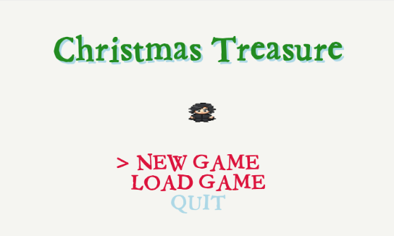
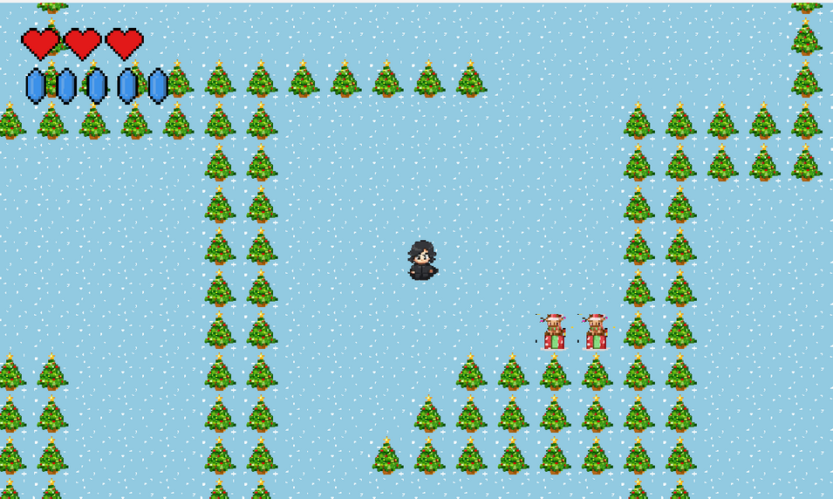
"New Game" to embark on your adventure
"Quit" to exit the application.
Game Start:
3 lives
5 energy

Slide 7

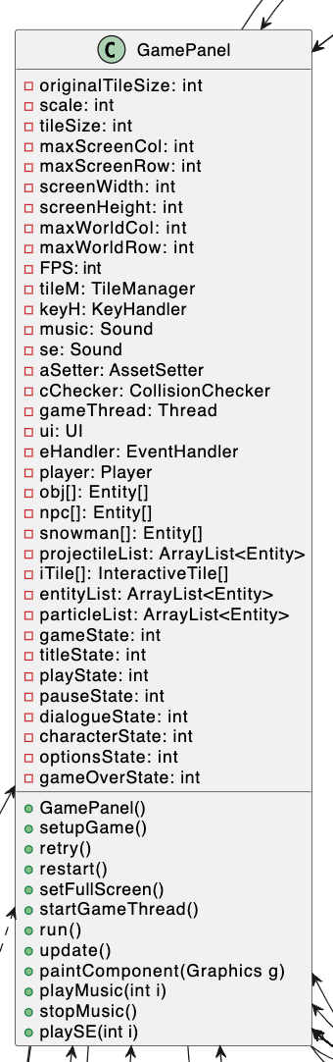
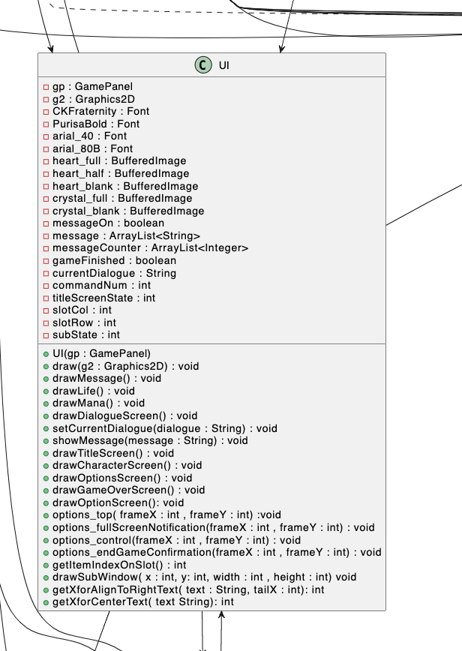
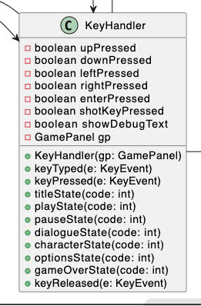

Slide 8
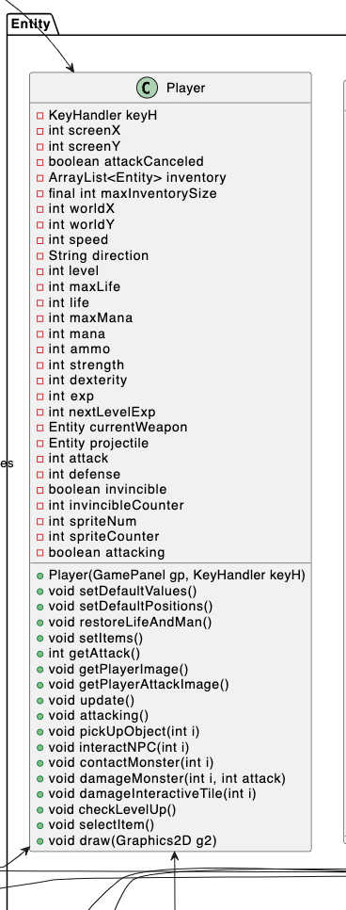
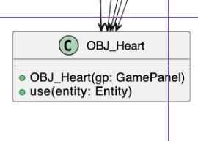
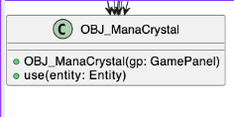

Slide 9
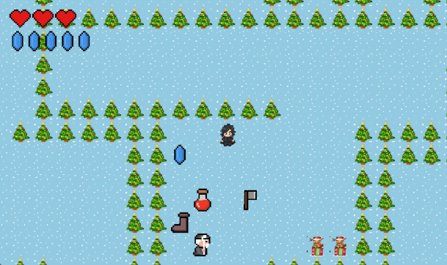
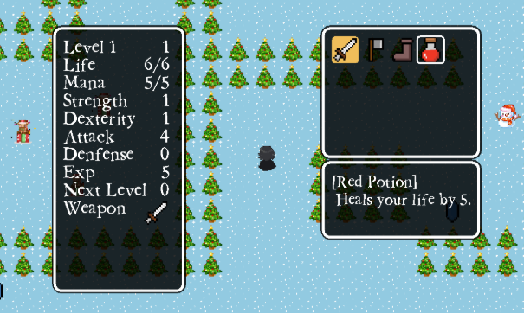
Collect items scattered throughout the maze
red_potion
axe
sword_normal
chirstmas_boot
manacrystal
The panel displays
character's status
inventory
instructions

Slide 10
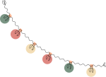
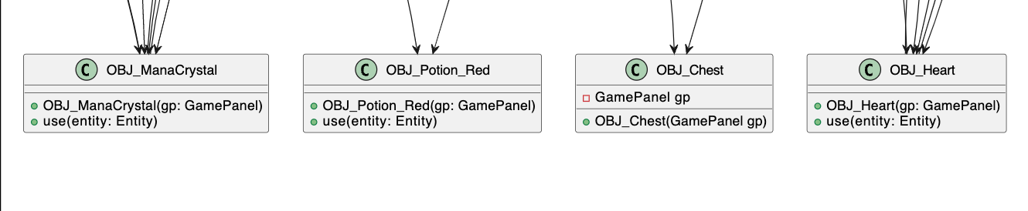
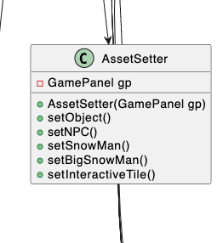

Slide 12
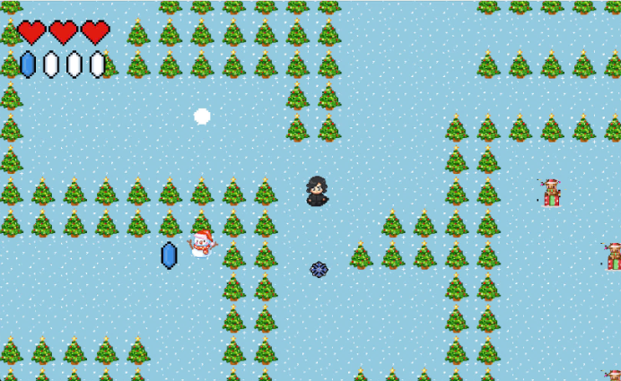
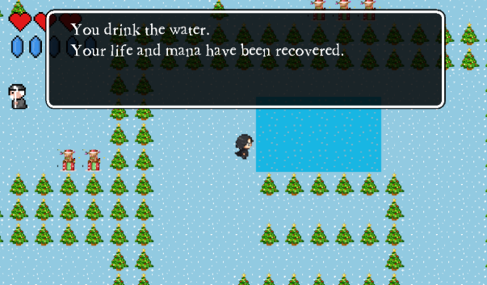

Snowball weapon
Each attack will consume 1 mana
Can restore mana with healing pools or random items along the way
is the strongest weapon

Slide 13

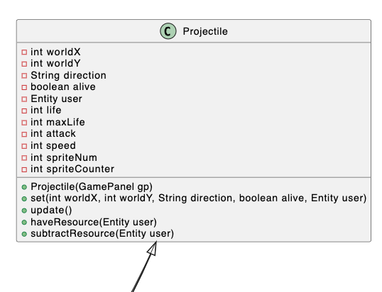
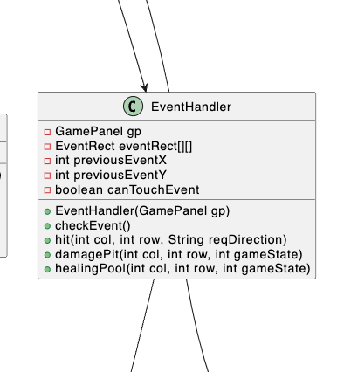

Slide 14
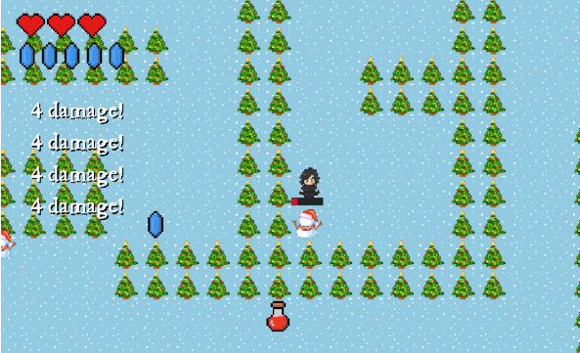
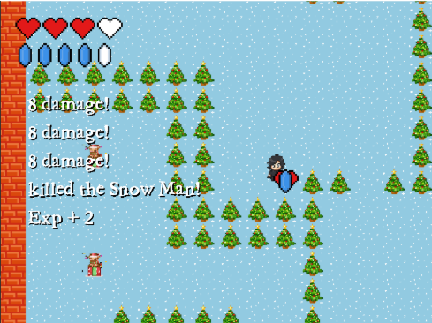
SnowMan Monsters:
Damage varies depending on the type of weapon used.
Killing more monsters helps level up faster and grants more lives.
Defeating monsters also rewards random items

Slide 15
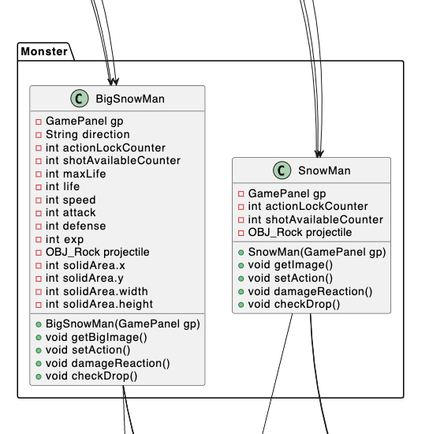

Slide 16
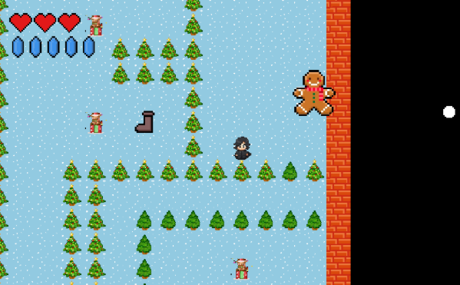
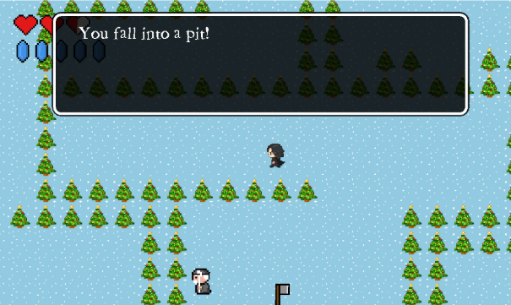
Biscuit Monster:
The final and most powerful monster guarding Santa's treasure
The Traps:
scattered around the map can also cause health loss

Slide 17


Slide 18

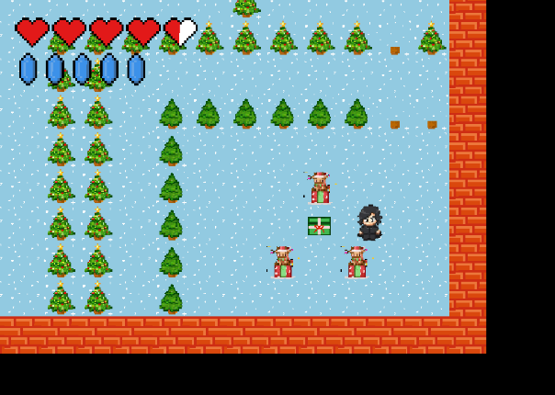
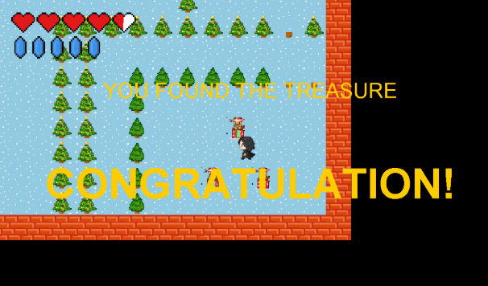
Find Treasure :
This is the gift that Santa left
Open it to win the game.

Slide 20
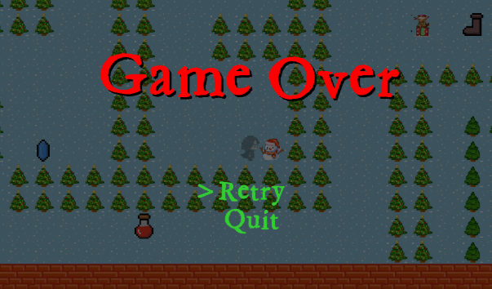
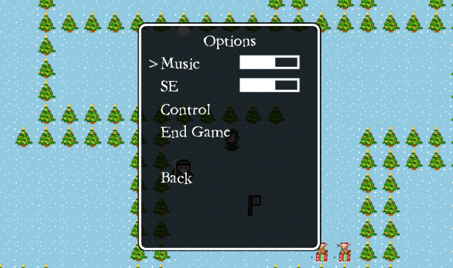
Game Over :
“Retry” revived with all items and levels.
“Quit” exit and returns to the "New Game" lobby.
Option Panel:
adjust volume
view keyboard controls
exit the game instantly

Slide 22

THE LOGIC DETAILS AND
GAME TECHNIQUE
KeyHandler.java
Keyboard Input Handing
Game State Transition
Inventory Interaction
Volume Adjustment and Options Menu

Slide 23


THE LOGIC DETAILS AND
GAME TECHNIQUE
2. Entity.java
Position & Collision
Sprite Animation
Attributes & Counters
Entity Types
Inventory & Items
Interactions & Dialogue
Movement & Pathfinding
Combat

Slide 24


THE LOGIC DETAILS AND
GAME TECHNIQUE
3. Player.java
Movement & Direction Handling
Attacking and Combat System
Inventory Management
Leveling Up
Graphics & Animation
Resource Handling
Interaction with NPCs
Modularize Methods for Readability

Slide 25

THE LOGIC DETAILS AND
GAME TECHNIQUE
4. GamePanel.java:
Screen and Window Settings
World Map Configuration
Entity and Object Management
Game State Handling
Game Loop
Graphics Rendering & Debugging
Audio Integration
Additional Functionalities

Slide 26

THE LOGIC DETAILS AND
GAME TECHNIQUE
5. CollisionChecker.java:
Purpose: Ensures entities don’t pass through objects, walls, or other entities.
Key Role: Maintains realism and interaction within the game world.

Slide 27

THE LOGIC DETAILS AND
GAME TECHNIQUE
6. AssetSetter.java:
Object Initialization
Object Placement on the Map
NPC and Monster Initialization
Interactive Tile Initialization

Slide 28

Thank you
for
listening

